Slide 1
Wired LANs:
Ethernet

Slide 2
    1 ETHERNET PROTOCOL
The data-link layer and physical layer are the territory of the local and wide area networks.
This means that when we discuss these two layers, we are talking about networks that are using them.
As we see in this course, we can have wired or wireless networks.
Notes:
13.#

Slide 3
1 IEEE Project 802
In 1985, the Computer Society of the IEEE started a project, called Project 802, to set standards to enable intercommunication among equipment from a variety of manufacturers.
Project 802 does not seek to replace any part of the OSI model or TCP/IP protocol suite.
Instead, it is a way of specifying functions of the physical layer and the data-link layer of major LAN protocols.
The relationship of the 802 Standard to the TCP/IP protocol suite is shown in next Figure.
Notes:
13.#

Slide 4
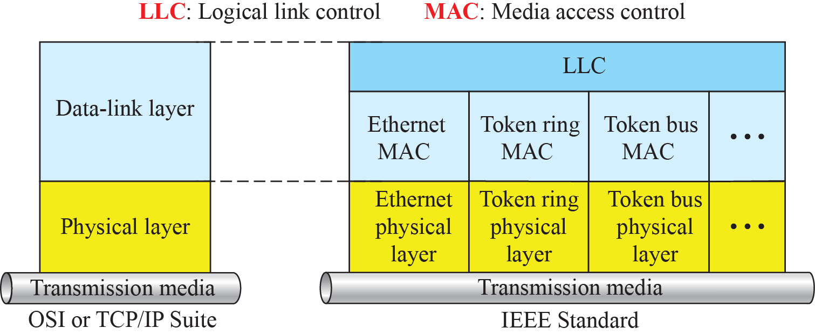
Figure 1: IEEE standard for LANs
Notes:
13.#

Slide 5
2 Ethernet Evolution
The Ethernet LAN was developed in the 1970s by Robert Metcalfe and David Boggs.
Since then, it has gone through four generations: Standard Ethernet (10 Mbps),
Fast Ethernet (100 Mbps),
Gigabit Ethernet (1 Gbps), and
10 Gigabit Ethernet (10 Gbps), as shown in next Figure.
Notes:
13.#

Slide 6
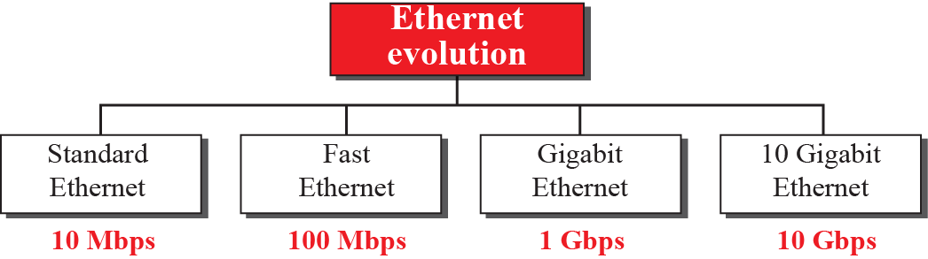
Figure 2 : Ethernet evolution
Notes:
13.#

Slide 7
    2 STANDARD ETHERNET
We refer to the original Ethernet technology with the data rate of 10 Mbps as the Standard Ethernet.
Although most implementations have moved to other technologies in the Ethernet evolution, there are some features of the Standard Ethernet that have not changed during the evolution.
Notes:
13.#

Slide 8
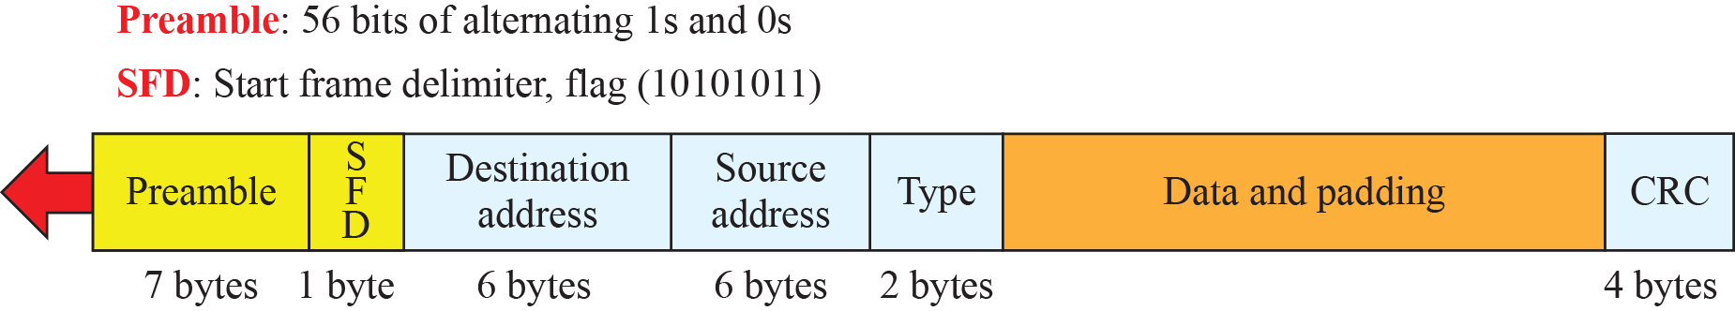
2.1 Characteristics
Let us first discuss some characteristics of the Standard Ethernet.
Figure 3: Ethernet frame
Notes:
13.#

Slide 9
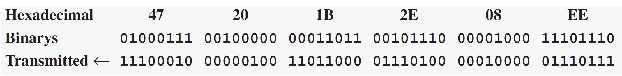
Example 1
Show how the address 47:20:1B:2E:08:EE is sent out online.
Solution
The address is sent left to right, byte by byte; for each byte, it is sent right to left, bit by bit, as shown below:

Slide 10
2.2 Addressing
Each station on an Ethernet network (such as a PC, workstation, or printer) has its own network interface card (NIC). The NIC fits inside the station and provides the station with a link-layer address. The Ethernet address is 6 bytes (48 bits), normally written in hexadecimal notation, with a colon between the bytes. For example, the following shows an Ethernet MAC address:
Notes:
13.#

Slide 11

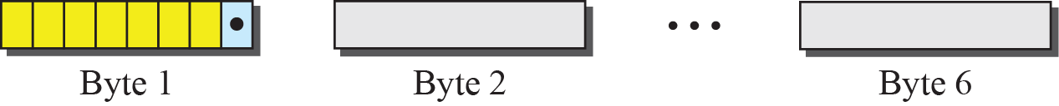
Figure 4: Unicast and multicast addresses
Notes:
13.#

Slide 12
Example 2
Define the type of the following destination addresses:
4A:30:10:21:10:1A
47:20:1B:2E:08:EE
FF:FF:FF:FF:FF:FF
Solution
To find the type of the address, we need to look at the second hexadecimal digit from the left. If it is even, the address is unicast. If it is odd, the address is multicast. If all digits are Fs, the address is broadcast. Therefore, we have the following:

Slide 13
Example 2 (continued)
a. This is a unicast address because A in binary is 1010
(even).
b. This is a multicast address because 7 in binary is 0111
(odd).
c. This is a broadcast address because all digits are Fs in
hexadecimal.

Slide 14
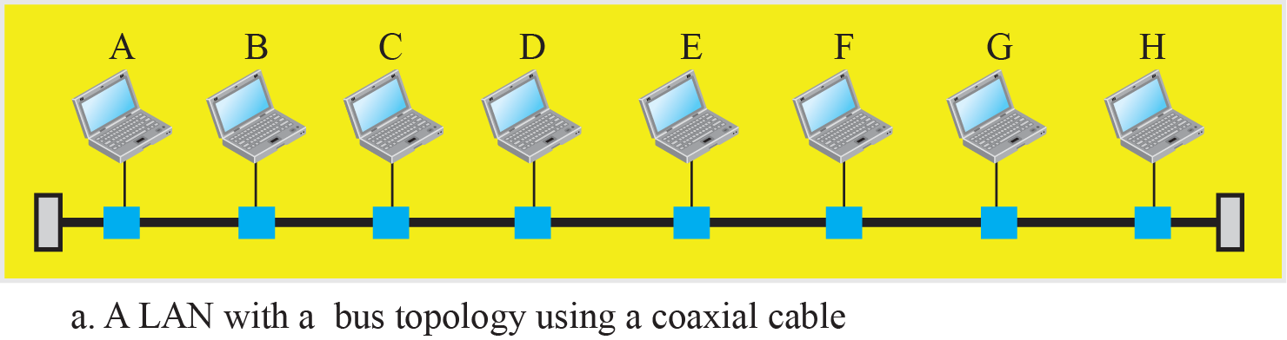
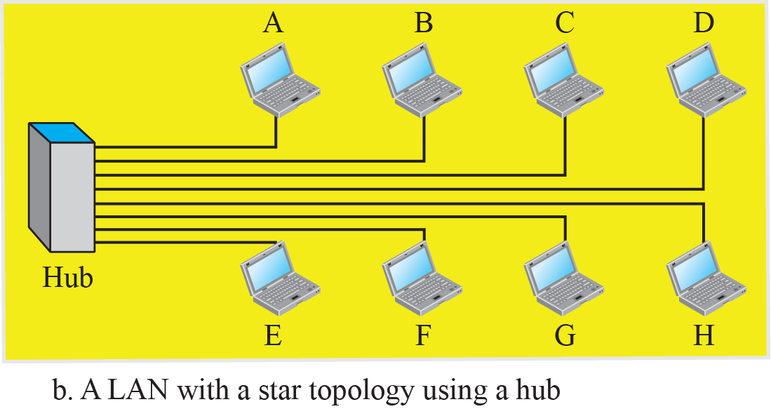
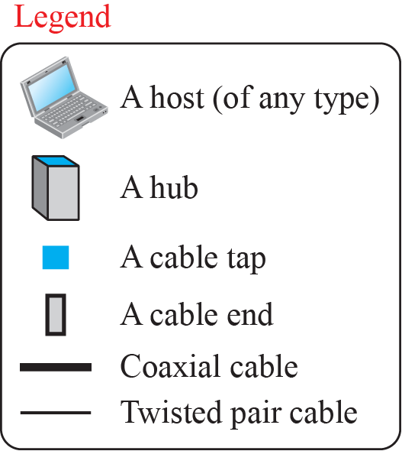
Figure 5: Implementation of standard Ethernet
Notes:
13.#

Slide 15
2.3 Access Method
Since the network that uses the standard Ethernet protocol is a broadcast network, we need to use an access method to control access to the sharing medium.
The standard Ethernet chose CSMA/CD with 1-persistent method.
Let us use a scenario to see how this method works for the Ethernet protocol.
Notes:
13.#

Slide 16
2.4 Efficiency of Standard Ethernet
The efficiency of the Ethernet is defined as the ratio of the time used by a station to send data to the time the medium is occupied by this station. The practical efficiency of standard Ethernet has been measured to be
Notes:
13.#

Slide 17
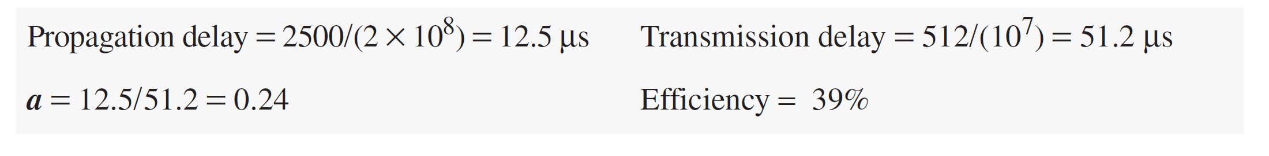
Example 3
In the Standard Ethernet with the transmission rate of 10 Mbps, we assume that the length of the medium is 2500 m and the size of the frame is 512 bits. The propagation speed of a signal in a cable is normally 2 × 10⁸ m/s.
The example shows that a = 0.24, which means only 0.24 of a frame occupies the whole medium in this case. The efficiency is 39 percent, which is considered moderate; it means that only 61 percent of the time the medium is occupied but not used by a station.

Slide 18
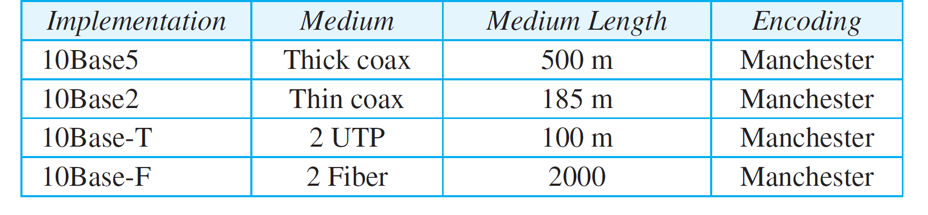
2.5 Implementation
The Standard Ethernet defined several implementations, but only four of them became popular during the 1980s. Table 1 shows a summary of Standard Ethernet implementations.
Table 1: Summary of Standard Ethernet implementations
Notes:
13.#

Slide 19
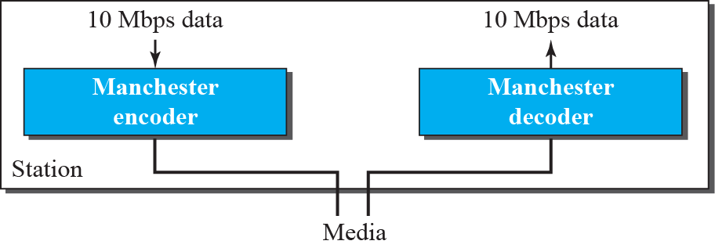
Figure 6: Encoding in a Standard Ethernet
Notes:
13.#

Slide 20
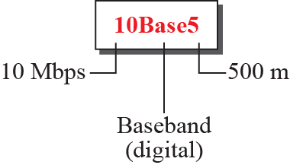
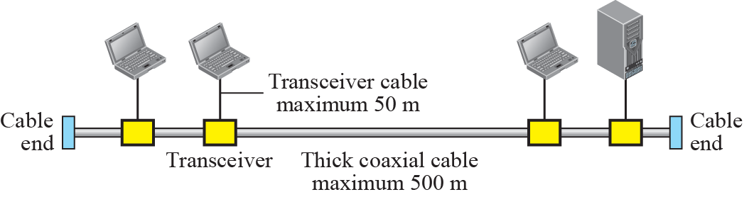
Figure 7: 10Base5 implementation
Notes:
13.#

Slide 21
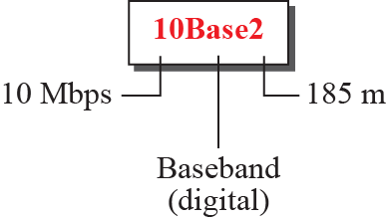
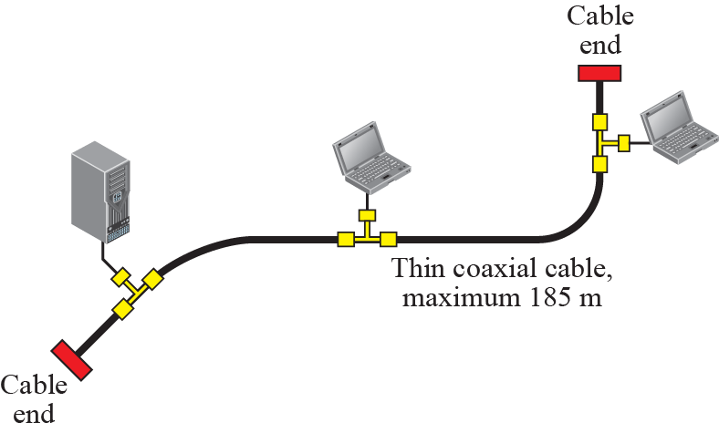
Figure 8: 10Base2 implementation
Notes:
13.#

Slide 22
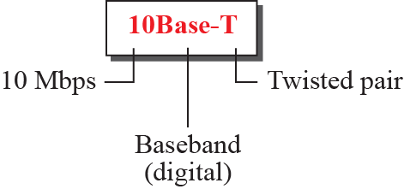
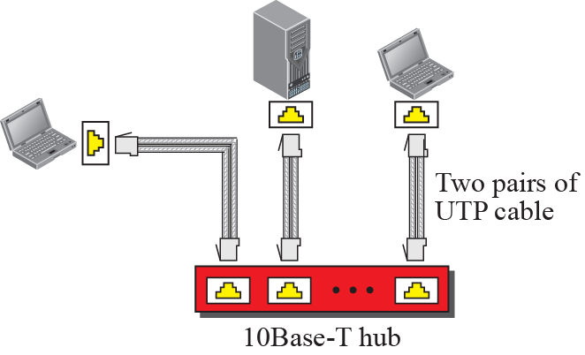
Figure 9: 10Base-T implementation
Notes:
13.#

Slide 23
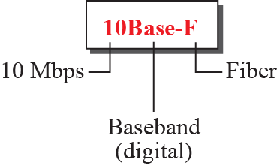
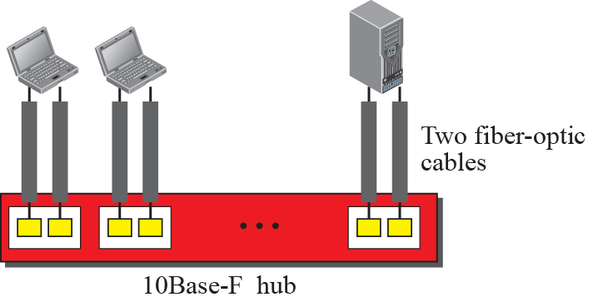
Figure 10: 10Base-F implementation
Notes:
13.#

Slide 24
2.6 Changes in the Standard
Before we discuss higher-rate Ethernet protocols, we need to discuss the changes that occurred to the 10-Mbps Standard Ethernet. These changes actually opened the road to the evolution of the Ethernet to become compatible with other high-data-rate LANs.
Notes:
13.#

Slide 25
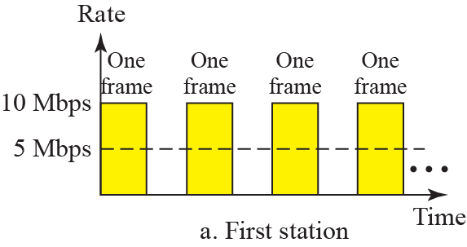
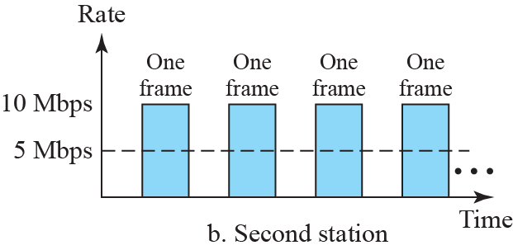
Figure 11: Sharing bandwidth
Notes:
13.#

Slide 26
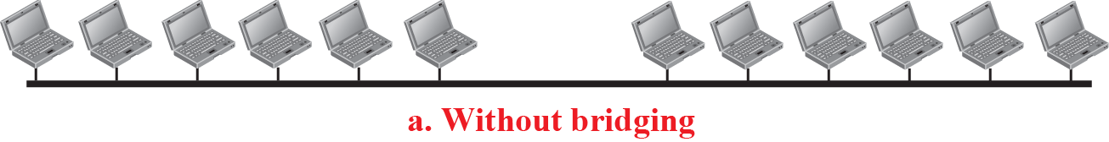
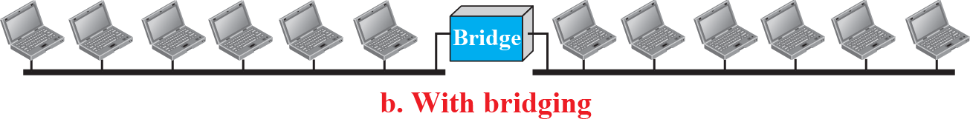
Figure 12: A network with and without bridging
Notes:
13.#

Slide 27
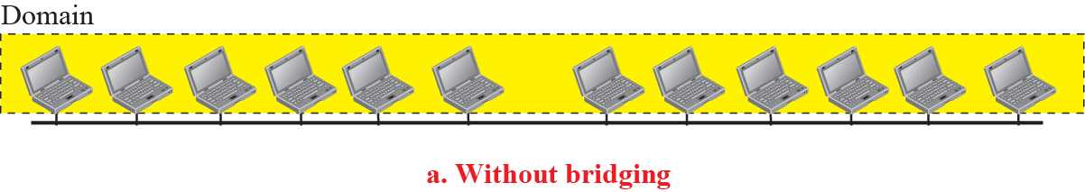
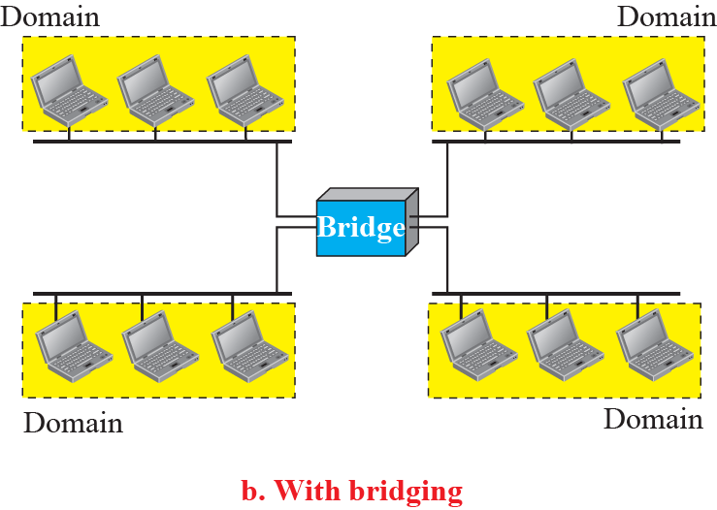
Figure 13: Collision domains
Notes:
13.#

Slide 28
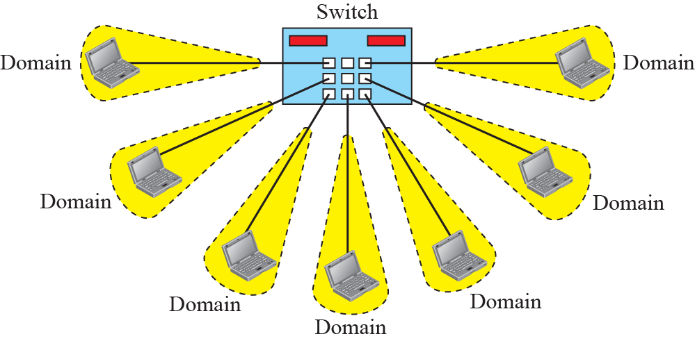
Figure 14: Switched Ethernet
Notes:
13.#

Slide 29
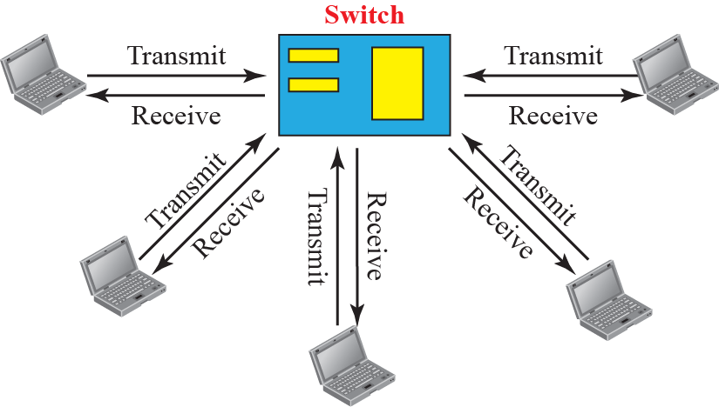
Figure 15: Full – duplex switched Ethernet
Notes:
13.#

Slide 30
    3 FAST ETHERNET
In the 1990s, Ethernet made a big jump by increasing the transmission rate to 100 Mbps, and the new generation was called the Fast Ethernet.
The designers of the Fast Ethernet needed to make it compatible with the Standard Ethernet.
The MAC sublayer was left unchanged. But the features of the Standard Ethernet that depend on the transmission rate, had to be changed.
Notes:
13.#

Slide 31
3.1 Access Method
We remember that the proper operation of the CSMA/CD depends on the transmission rate, the minimum size of the frame, and the maximum network length.
If we want to keep the minimum size of the frame, the maximum length of the network should be changed.
In other words, if the minimum frame size is still 512 bits, and it is transmitted 10 times faster, the collision needs to be detected 10 times sooner, which means the maximum length of the network should be 10 times shorter (the propagation speed does not change).
Notes:
13.#

Slide 32
3.2 Physical Layer
To be able to handle a 100 Mbps data rate, several changes need to be made at the physical layer.
Notes:
13.#

Slide 33
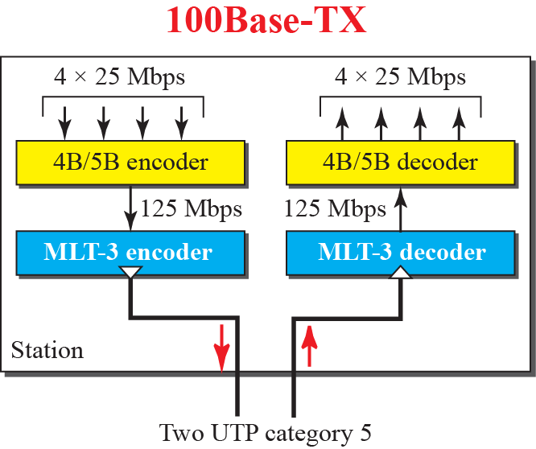
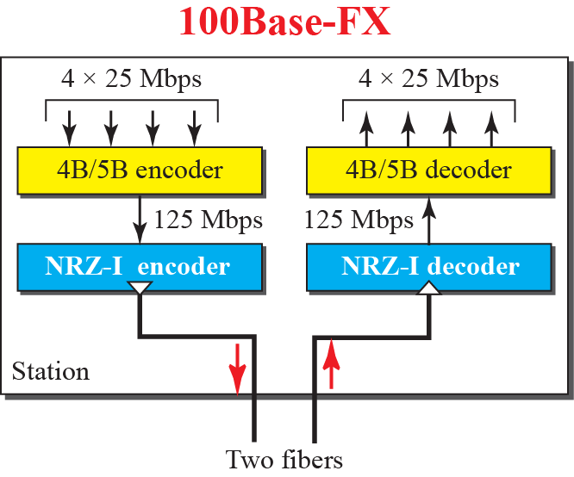
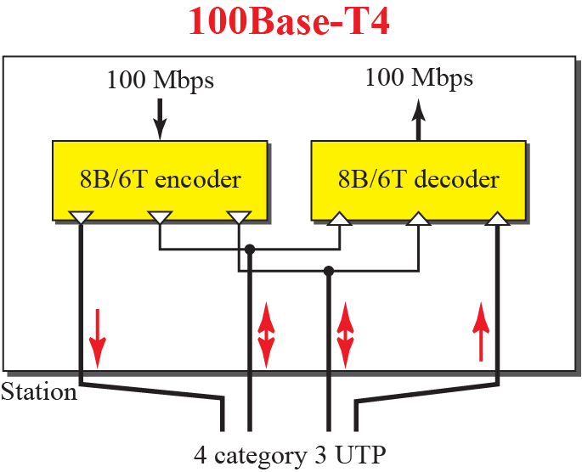
Figure 16: Encoding for fast Ethernet
Notes:
13.#

Slide 34

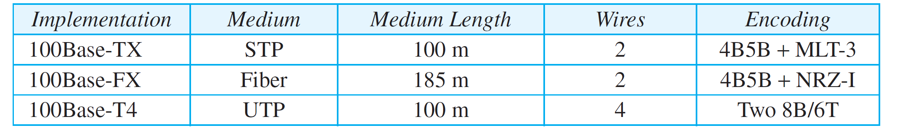
Table 2: Summary of Fast Ethernet implementations

Slide 35
    4 GIGABIT ETHERNET
The need for an even higher data rate resulted in the design of the Gigabit Ethernet Protocol (1000 Mbps).
The IEEE committee calls it the Standard 802.3z.
The goals of the Gigabit Ethernet were to upgrade the data rate to 1 Gbps, but keep the address length, the frame format, and the maximum and minimum frame length the same.
Notes:
13.#

Slide 36
4.1 MAC Sublayer
A main consideration in the evolution of Ethernet was to keep the MAC sublayer untouched.
However, to achieve a data rate of 1 Gbps, this was no longer possible.
Gigabit Ethernet has two distinctive approaches for medium access: half-duplex and full-duplex.
Almost all implementations of Gigabit Ethernet follow the full-duplex approach, so we mostly ignore the half-duplex mode.
Notes:
13.#

Slide 37
4.2 Physical Layer
The physical layer in Gigabit Ethernet is more complicated than that in Standard or Fast Ethernet. We briefly discuss some features of this layer.
Notes:
13.#

Slide 38
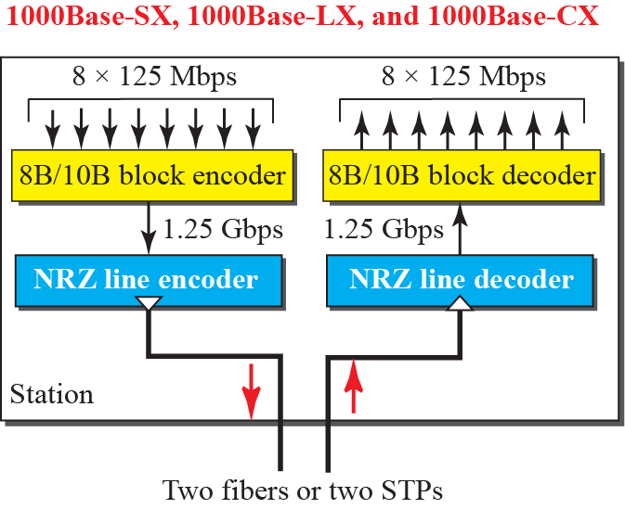
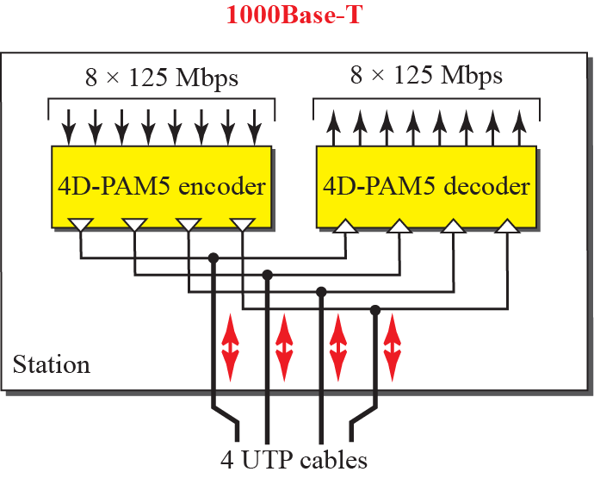
Figure 17: Encoding in Gigabit Ethernet
Notes:
13.#

Slide 39
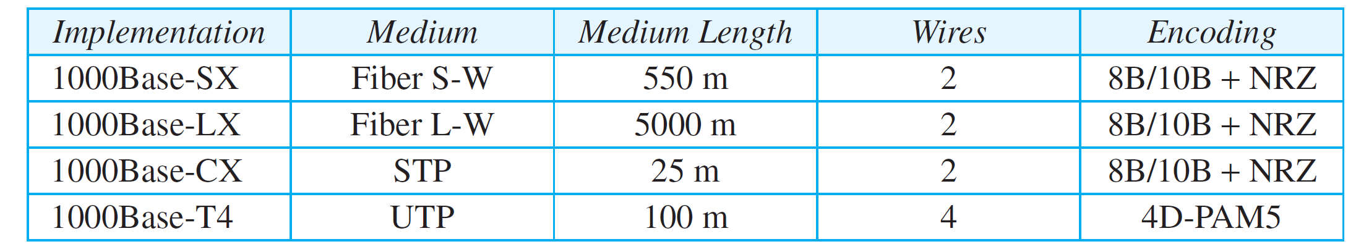
Table 3: Summary of Gigabit Ethernet implementations

Slide 40
    5 10-GIGABIT EHTERNET
In recent years, there has been another look into the Ethernet for use in metropolitan areas.
The idea is to extend the technology, the data rate, and the coverage distance so that the Ethernet can be used as LAN and MAN (metropolitan area network).
The IEEE committee created 10 Gigabit Ethernet and called it Standard 802.3ae.
Notes:
13.#

Slide 41
5.1 Implementation
10 Gigabit Ethernet operates only in full-duplex mode, which means there is no need for contention; CSMA/CD is not used in 10 Gigabit Ethernet.
Four implementations are the most common: 10GBase-SR, 10GBase-LR, 10GBase-EW, and 10GBase-X4. Table 13.4 shows a summary of the 10 Gigabit Ethernet implementations.
Notes:
13.#

Slide 42
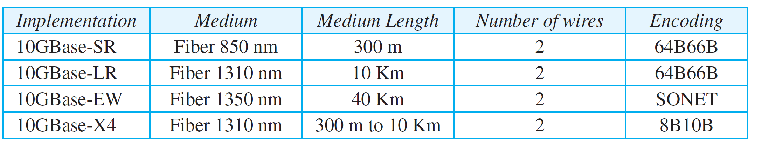
Table 4: Summary of 10-Gigabit Ethernet implementations

